Slide 1
Skin Lesion Classification
Matthew Sawchuk, Joseph Fee, Dylan Grengs, Jacob Rohde

Slide 2
Outline
Introduction / Background
Related Work
Dataset
Models
SVM
CNN
Decision Tree
Experimental Results
Conclusions / Future Work

Slide 3
Background
2015 global incidence of melanoma was estimated to be over 350,000 cases with over 60,000 deaths
When detected early melanoma survival rate exceeds 95%. Though making appointments can be time consuming and expensive
Medical professionals were able to identify lesions with 70.5% accuracy (Younger ~ 60%) (Senior ~ 80%)
Notes:
Here we have some facts and background information on some of the problems associated with skin cancer that machine learning could attempt work towards solving.
First off skin cancer is deadly and widespread. - - - - read top left slide graphic - - - -
Fortunately enough there is an easy way to fight against it.
Though screening for skin cancer isn't as cut and dry as it may seem.

Slide 4
Goals
Implement an SVM
Implement a convolutional neural network
Will machine learning models would be able to recognize the subtle differences between classifications making identifying possibly cancerous lesions quick and cheap.
Implement a decision tree from scratch
Achieve an accuracy of at least 70%
Notes:
These difficulties lead our group to coming up with our project idea, that would be able to alleviate some of the problems that arise from skin cancer.
From this we were able to create the following four goals for the project. - - - read top left three - - - Three are to implement some specific machine learning algorithms that all have history of performing well in classification problems. Lastly, based on the statistic about medical professionals we wanted to be able to at least match or outperform their accuracy (70%).

Slide 5
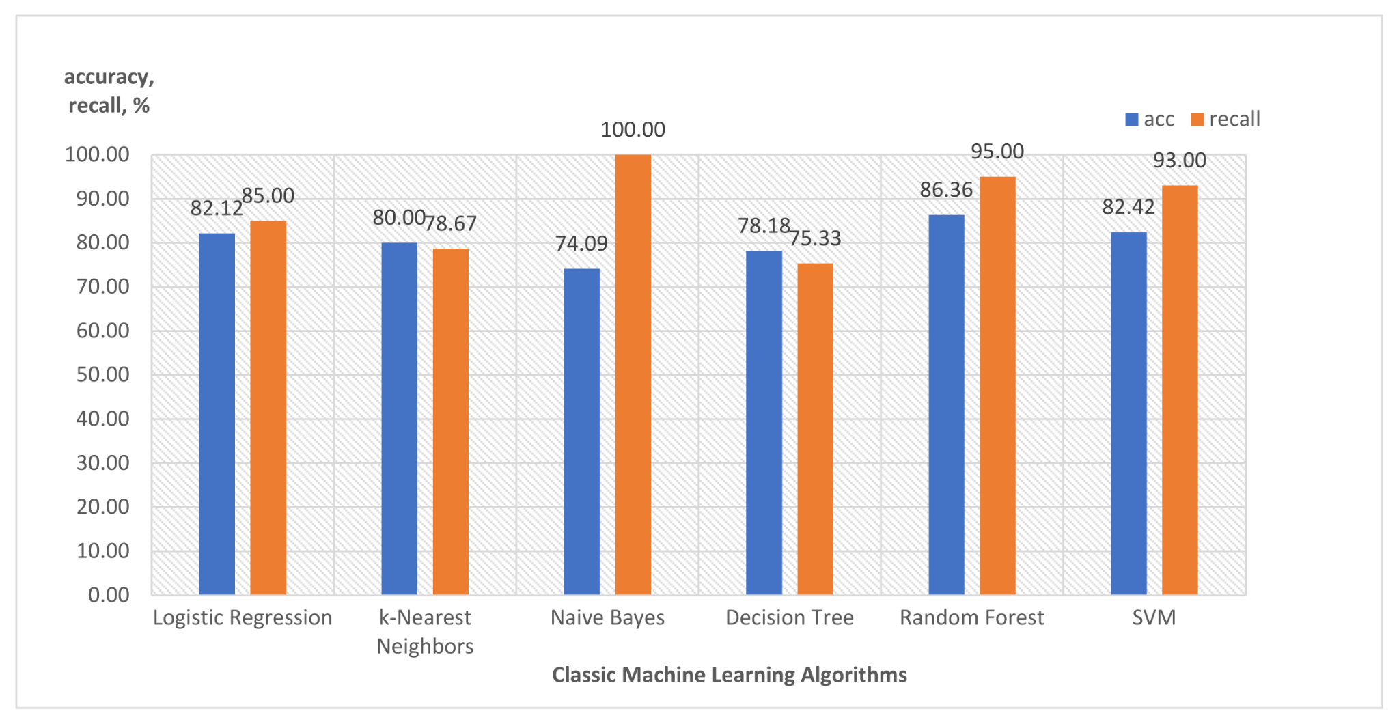
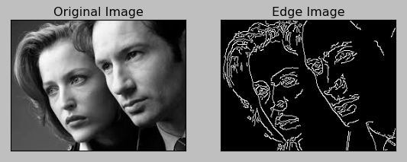
Related Work
Skin Lesion Classification
Image Preprocessing
Notes:
We will try to focus mainly on or results although there are two things that we wanted to bring up about related and previously done work.
Firstly is a paper that was published this September which compares multiple different machine learning algorithms. This paper showed that classification of skin lesions can be successfully a variety of ways including algorithms that did not utilize a neural network. All algorithms displayed were able to get an accuracy of at least 74%. With the worst being naive bayes and the best being decision forest with 86. Notably this paper was able to get an accuracy of 90% using a pre-trained neural network.
Secondly for training so called “classical” machine learning algorithms we will need to have a more rigorous preprocessing for training images. The second paper published in 2007. Goes over optimal edge detection strategies of phone quality images for skin lesion classification. The paper concluded that of the methods considered that the canny edge detection was the first, sobel was the second best performing, and roberts was the worst.

Slide 6
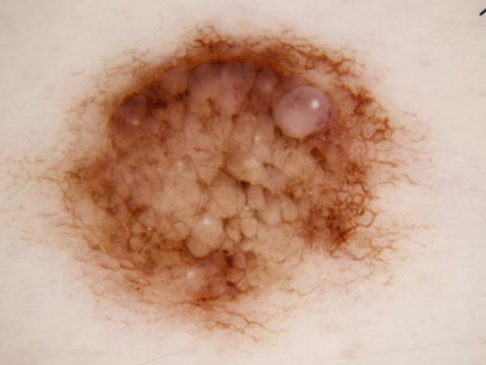
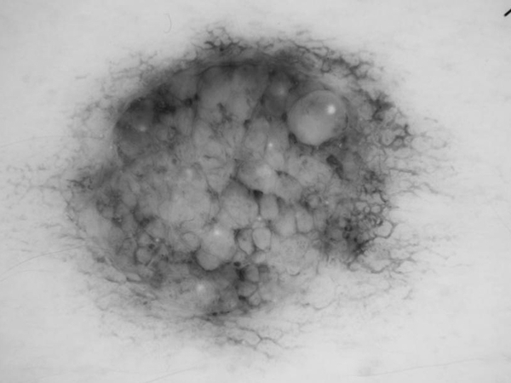
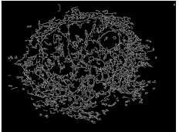
Input Features
Only images and correct classification are used as input for training, no other metadata.
Images are translated to grayscale, downsized, and then passed through the canny edge detection algorithm for input into Support Vector Machine and Decision Tree
Convolutional Neural Network takes images that are only downsized.

Slide 7
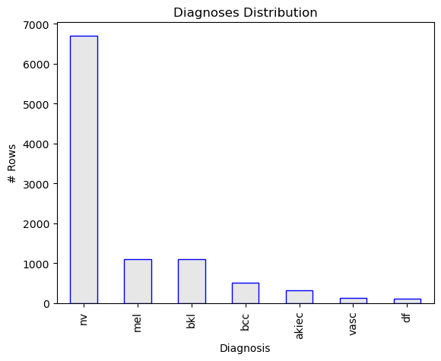
Response Variable
nv Melanocytic Nevus
mel Melanoma
bkl Benign Keratosis
bcc Basal Cell Carcinoma
akiec Actinic Keratosis
vasc Vascular Lesion
df Dermatofibroma

Slide 8
SVM - Model
Implemented using the scikit-learn library, useful for creating the model and testing it.
svm.SVC function is used to implement the model
Results with the highest accuracy use the parameters “rbf” for the kernel, and “ovo” for the function shape, with the rest as default.
The grid search method “GridSearchCV” was used to determine the ideal parameters, and k-fold cross validation using “cross_validate” was performed to get a better accuracy assessment.

Slide 9
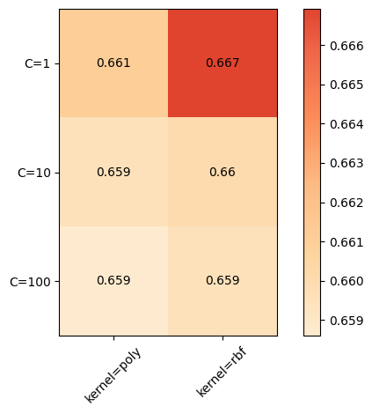
SVM - Process
‘rbf’ (radial basis function) and polynomial work best, linear tends to perform worse.
The sklearn grid search method creates models for all of the different permutations of inputs using k-fold cross validation with 3 folds for each.
This process takes a long time and is best done in small batches. This test took 326 minutes. One with 12 permutations ran for over 1800 minutes, but never finished.
AMD Ryzen 5 5500U with Radeon Graphics 2.10 GHz

Slide 10
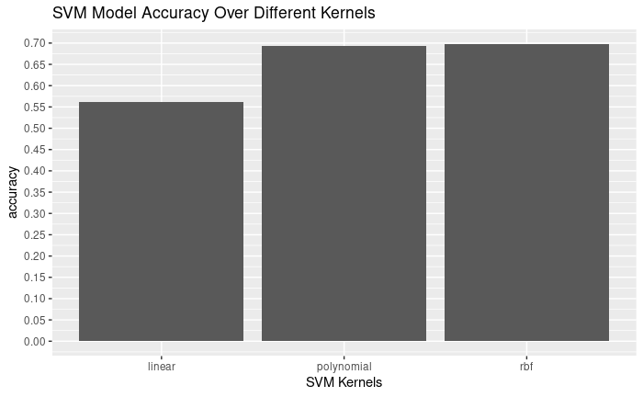
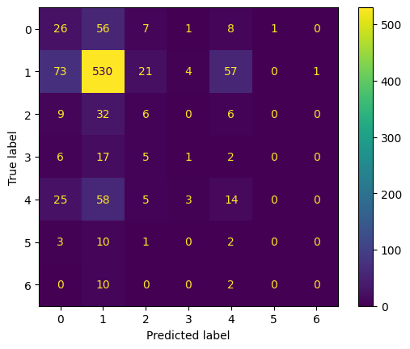
SVM Insight
Confusion Matrix from linear kernel, C = 1
Accuracy: 0.553, Precision: 0.171, Recall: 0.169*
* Metrics are calculated with the “macro” average

Slide 11
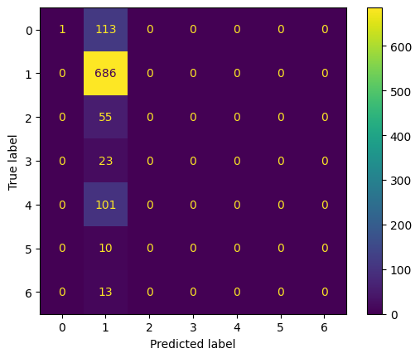
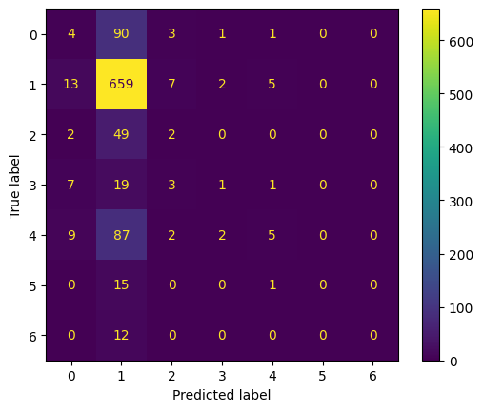
SVM - Results
Confusion Matrix from RBF kernel, C = 1
Confusion Matrix from polynomial kernel, C = 10
Accuracy: 0.681, Precision: 0.094, Recall: 0.143
Accuracy: 0.669, Precision: 0.268, Recall: 0.169

Slide 12
Neural Network Models
Classic 3 Layer
Custom Convolutional Network
Convolutional Network from Paper
Transferred Learning on DenseNet201
Single hidden layer
256 neurons wide
Created from scratch
2 convolutional layers
4 dense layers
Edited Convolutional filter sizes
Different input sizes and shape
DenseNet used for image classification of objects
Trained last 4 layers
All models were trained with an 90% of the datasets images
Each model had an input of a 144x108 images, resized from 600x450
Every model was trained on color images
Each model was created using Keras and TensorFlow
All used a softmax activation function for the output
Notes:
Next we go over our neural networks
We had 4 nn, three convolutional/ deep networks and 1 classic 3 layer network

Slide 13
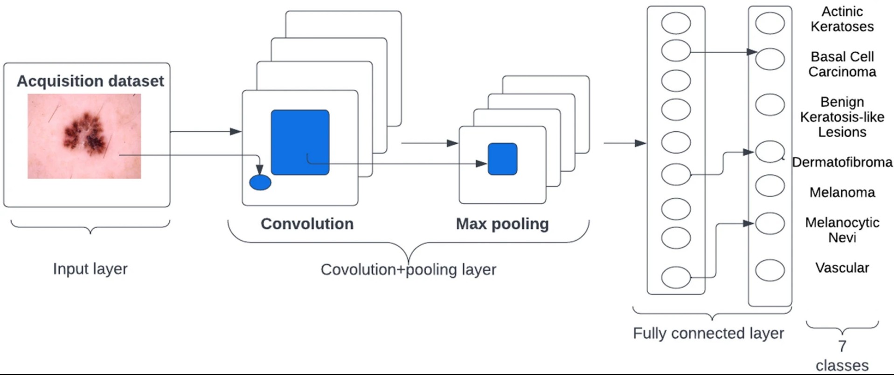
Convolutional Network Architectures

Slide 14
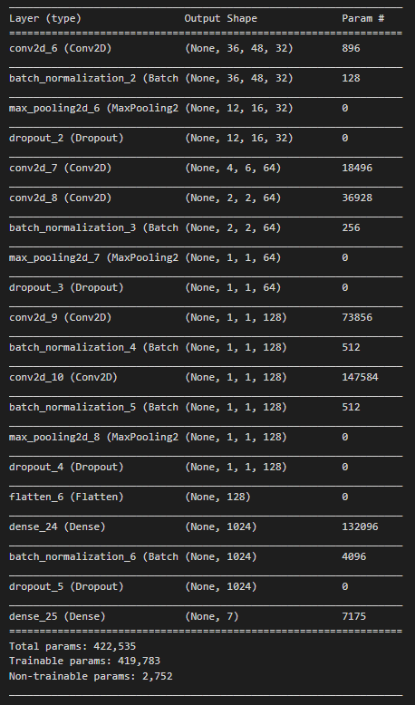
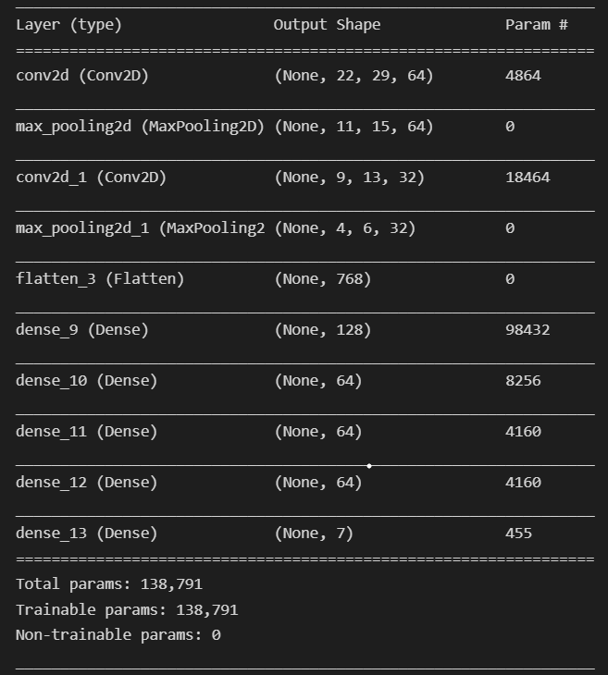
Edited Paper Network
Custom Network
Tweaked Network

Slide 15
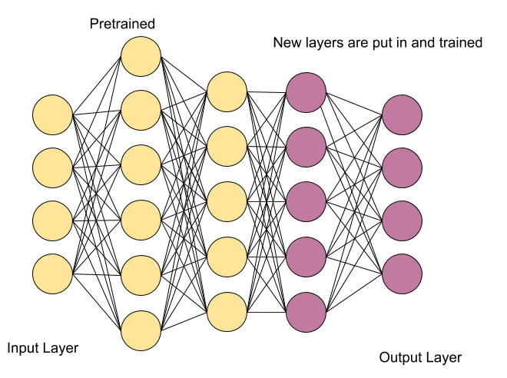
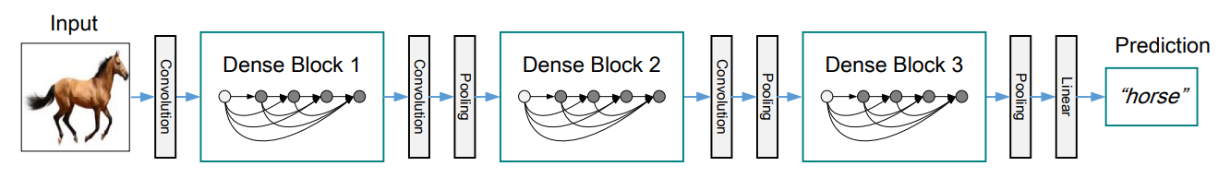
DenseNet201 Architecture
DenseNet-201 is a convolutional neural network that is 201 layers deep and trained on over one million images
The pretrained network can classify images into 1000 object categories
We edited the first layer to take our image shape, and last layer to output 7 vs 1000 classes, and trained the last 8 layers
Notes:
Dense networks to get over vanishing gradient problem by passing output form each neuron into all subsequent dense layers in each dense block as seen in the graphic.

Slide 16
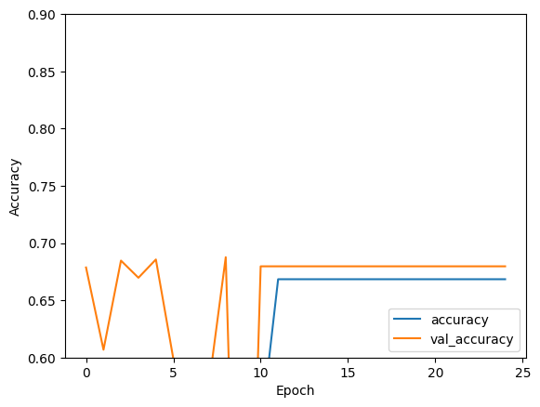

3 Layer Neural Network Result

Slide 17
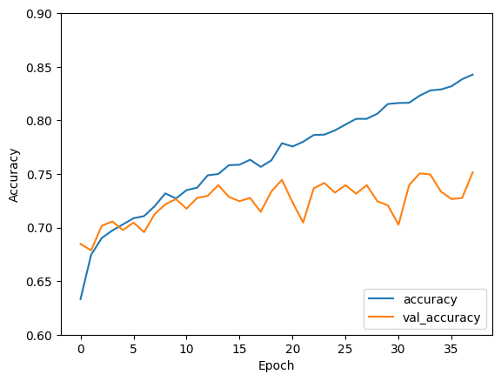

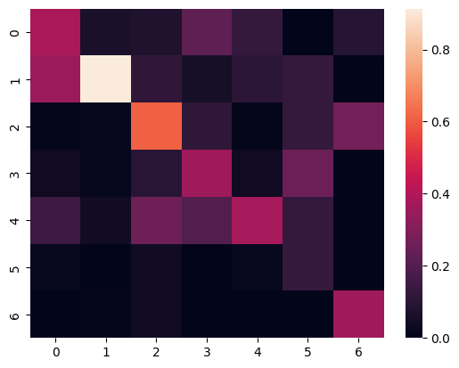
Convolutional Neural Network Results
Custom Network
76.8

Slide 18

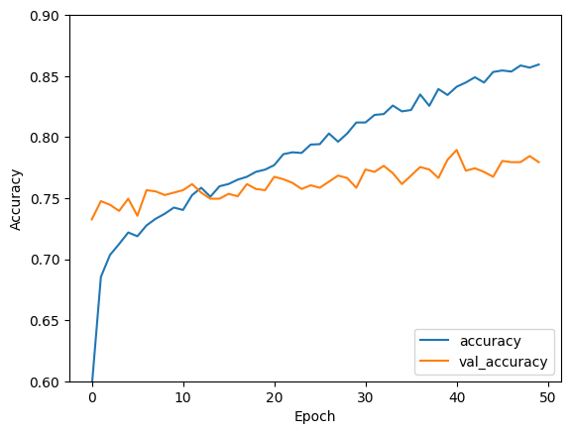
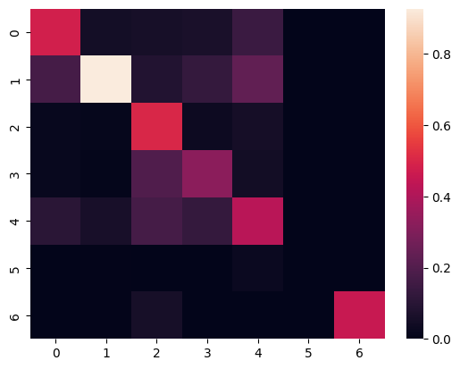
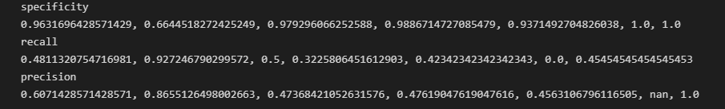
Dense Net
78.74

Slide 19

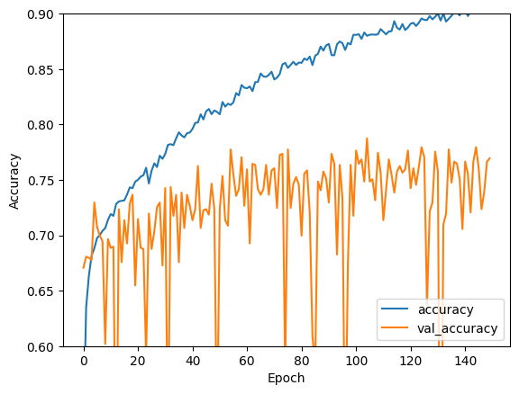
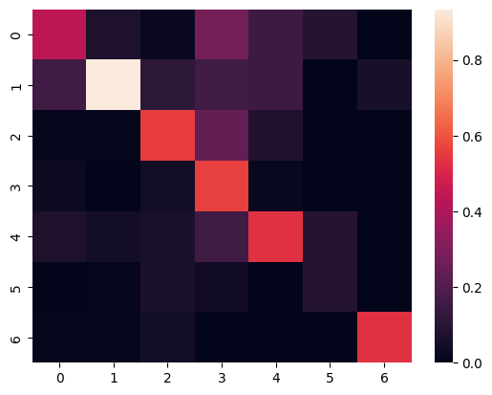
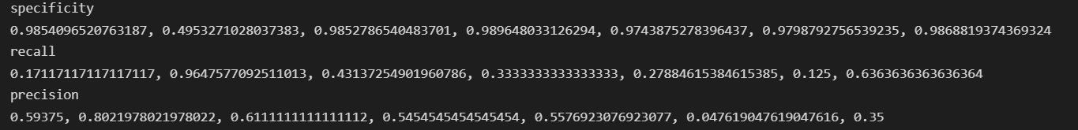
Tweaked Paper Network
78.74
78.74

Slide 20
Decision Tree
Algorithm implemented by hand, including best split functions
Splits determined by:
GINI
Information Gain
Hyperparameters were evaluated via K-Fold Cross Validation
3 Rounds Were Conducted
Parameters include: max depth, split function, and image resolution
Best model was created using information gain and max depth 6

Slide 21
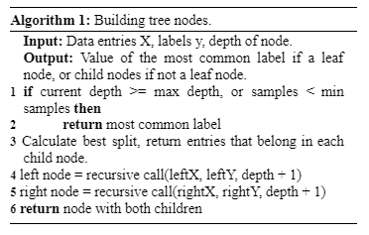
DT Implementation

Slide 22
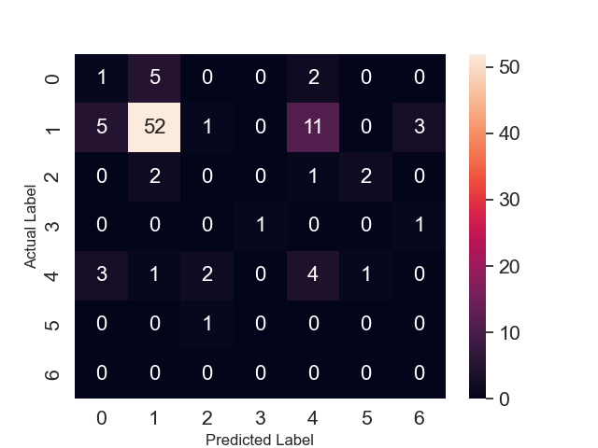
Round 1 K-Fold Cross Validation Result
Range of Max Depths: 10-100
Max Depth: 10
Best Split Method: Information Gain
Image Resolution: 96 x 72
Accuracy: ~59%
Recall: 0.125, 0.72, 0, 0.5, 0.36, 0, 0
Precision: 0.11, 0.87, 0, 1, 0.22, 0, 0
F-Measure: 0.12, 0.79, 0, 0.67, 0.27, 0, 0

Slide 23
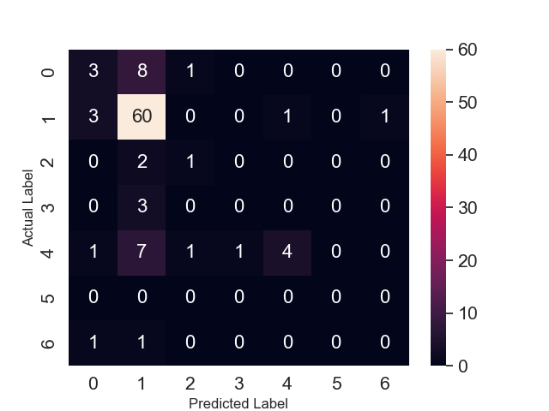
Round 2 K-Fold Cross Validation Result
Range of Max Depths: 5 - 14
Max Depth: 6
Best Split Method: Information Gain
Image Resolution: 144 x 108
Accuracy: ~69%
Recall: 0.25, 0.92, 0.33, 0, 0.29, 0, 0
Precision: 0.375, 0.74, 0.33, 0, 0.8, 0, 0
F-Measure: 0.3, 0.82, 0.33, 0, 0.43, 0, 0

Slide 24
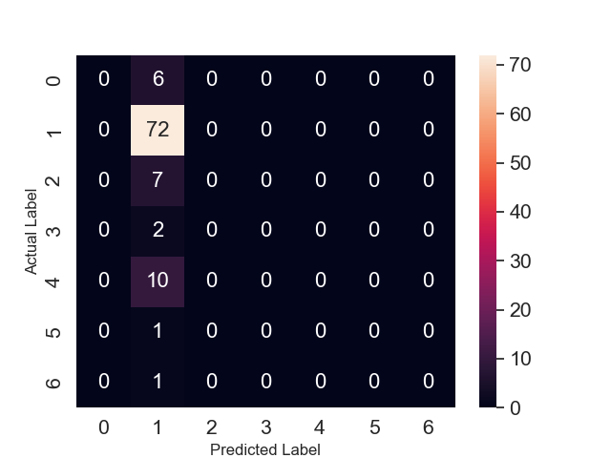
Round 3 K-Fold Cross Validation Result
Range of Max Depths: 5 - 14
Max Depth: 11
Best Split Method: GINI
Image Resolution: 144 x 108
Accuracy: ~73%
Recall: 0, 1, 0, 0, 0, 0, 0
Precision: 0, 0.73, 0, 0, 0, 0, 0
F-Measure: 0, 0.84, 0, 0, 0, 0, 0

Slide 25
Results of K-Fold Cross Validation
The model built in round 2 was decided to be the best model.
Although the third model built from results of KFCV3 had the highest accuracy, recall, and f-measure, that was only for the NV diagnosis type.
Model built in KFCV3 only guessed NV
Some correct predictions made by model 2 of round 2 included other diagnoses aside from NV.
Model 2 from Round 2 of KFCV

Slide 26
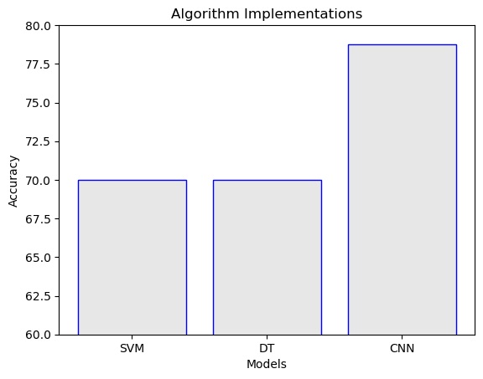
Experimental Results
Our Decision Tree implementation reached a respectable accuracy
69% ~ 73%
We achieved our best accuracy using a Convolutional Neural Network
78.74%
The Support Vector Machine model was close at
69.98%

Slide 27
Conclusions
Due to CNNs high dimensionality capabilities, it’s only natural it exceeded at our classification task. It is a deep neural network capable of working well with a high density of pixel information
Runs image feature extraction and classification in one algorithm
Tweaked paper model had 18 internal layers
Better collaboration required to begin pooling medical images so these models may be better fit in the future
High potential to help in many medical fields

Slide 28

Data Imbalance
Dealing with nv (Melanocytic Nevus) data imbalance
Oversampling (of smaller classes)
Image Augmentation, Bootstrapping, SMOTE, etc.
Undersampling (of nv class)
Don’t want to improperly misrepresent/bias our data
Highlight the need for better consolidation of medical imagery

Slide 29
Future Work
Continue fine-tuning hyperparameters and exploring the potential of these low level tweaks improving overall performance
Our SVM could reach a slightly higher accuracy with further experimentation
Break the 70% goal
Puts it in competition with our Decision Tree
Experiment with Random Forest using our Decision Tree work

Slide 30
Questions?

Slide 31
References
Bistroń, M., & Piotrowski, Z. (2022). Comparison of machine learning algorithms used for skin cancer diagnosis. Applied Sciences, 12(19), 9960. https://doi.org/10.3390/app12199960
Das, K., Cockerell, C. J., Patil, A., Pietkiewicz, P., Giulini, M., Grabbe, S., & Goldust, M. (2021). Machine learning and its application in skin cancer. International Journal of Environmental Research and Public Health, 18(24), 13409. https://doi.org/10.3390/ijerph182413409
GeeksforGeeks. (2018, June 20). Creating linear kernel SVM in Python. https://www.geeksforgeeks.org/creating-linear-kernel-svm-in-python/
Hua, K. L. (2007). A comparison of edge detection methods for segmentation of skin lesions in mobile-phone-quality images. Research Online. Retrieved November 22, 2022, from https://ro.ecu.edu.au/theses_hons/1275/
ManMohan. (2019, May 26). 16 SKLearn - SVM RBF Kernel. Kaggle. https://www.kaggle.com/code/manmohan291/16-sklearn-svm-rbf-kernel
Tschandl, P., Rosendahl, C., & Kittler, H. (2018). The HAM10000 dataset, a large collection of multi-source dermatoscopic images of common pigmented skin lesions. Scientific Data, 5(1). https://doi.org/10.1038/sdata.2018.161

